Slide 1




Testing in React 18
React Testing Primer

Slide 2


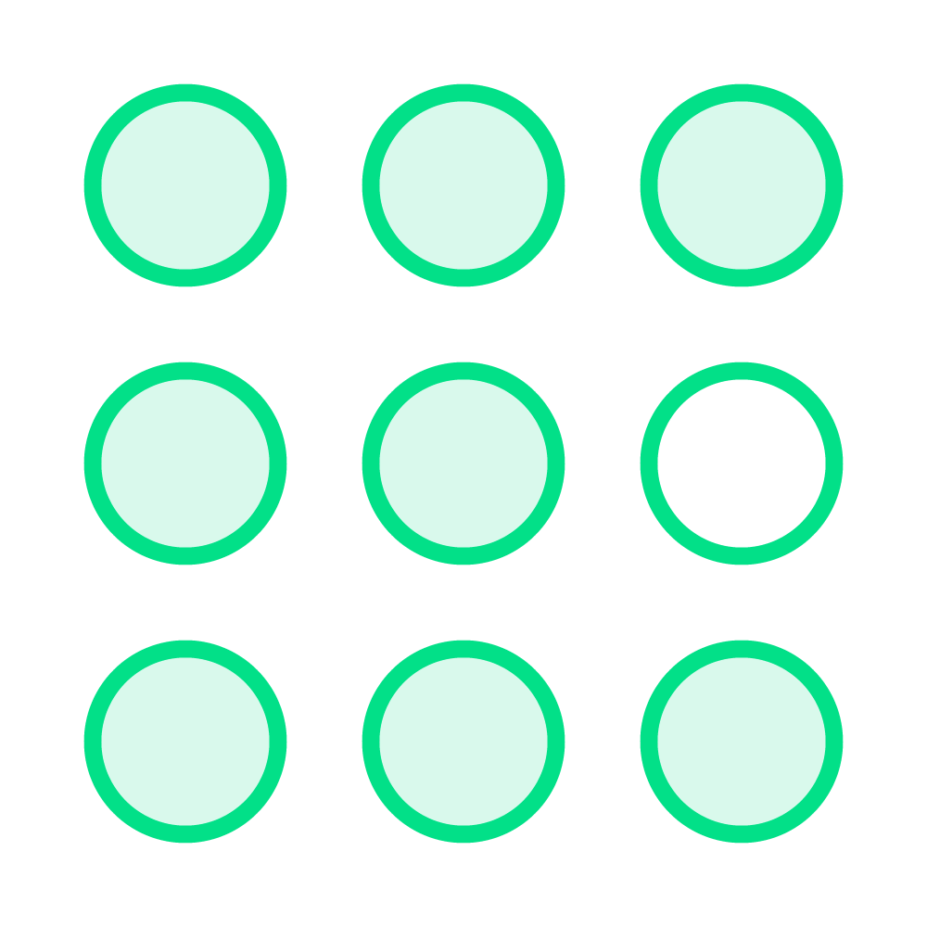

About This Course
“Cookbook” format
Independent modules
React and testing

Slide 3

Tech Stack
Automated Software Testing
JavaScript
React
Unit Testing
Jest

Slide 4
Testing React
How We Test
React
Rendering
Provide various input data and verify that the rendered output matches expectations.
Event Management
Simulate the user interaction. Verify that the resulting events match what is expected.

Slide 5
◀ Render <Counter start={1} /> and look for ‘1’ in the rendered result
const Counter = ({start}) => { return (
<div>{start}</div>
);
};

Slide 6
◀ Render Counter, simulate a click on the div, and assert that ‘onIncrement’ was called.
const Counter = ({start, onIncrement}) => { return (
<div onClick={()=>{ onIncrement(); }}>
{start}
</div>
);
};

Slide 7
Creating a React Application With a Test
npx create-next-app --example with-jest testing-react

Slide 8
Adding Tests to an Existing React Application
npx create-next-app without-tests
npm install jest --save-dev

Slide 9
Adding Tests to an Existing React Application
package.json
npm test
{
…
"scripts": {
"dev": "next dev", "build": "next build", "start": "next start", "lint": "next lint",
"test": "jest"
}
…
}

Slide 10

Summary
Testing in React

